Slide 1


Website Company Brief
Brief for Arigeo corporate website
UX/UI inspired by Kao Global, applied with Arigeo white / red / black identity.
Household
Skincare
Corporate Trust
For agency briefing / UX UI website quotation

Slide 2


Project context
Arigeo needs one corporate website to introduce the company and connect users to its household and skincare portfolio.
3 brand families under Arigeo
Captainmaid
GenuLeaf
CeraTory
Household launches
Skincare launches
Derma skincare launches
HOUSEHOLD FOUNDATION
Captainmaid covers floor cleaner, kitchen cleaner, glass cleaner, dishwash, hand wash, bathroom cleaner, washing machine cleaner and anti-bac home care.
SKINCARE FOUNDATION
GenuLeaf and CeraTory focus on soothing, brightening, barrier repair, cleansing and acne-care product lines
ARIGEO WEBSITE BRIEF

Slide 3
Build a digital home for Arigeo: credible like a corporate site, clear like a brand gateway, and flexible for future launches.
01
02
03
Corporate credibility
Brand discovery
Launch-ready CMS
( Content Management System)
Company story
Quality & innovation
Trust for partners and consumers
Add new products easily
News & PR modules
SEO-ready content structure
Portfolio by category
Clear product benefits
Easy route to brand pages
ARIGEO WEBSITE BRIEF

Slide 4
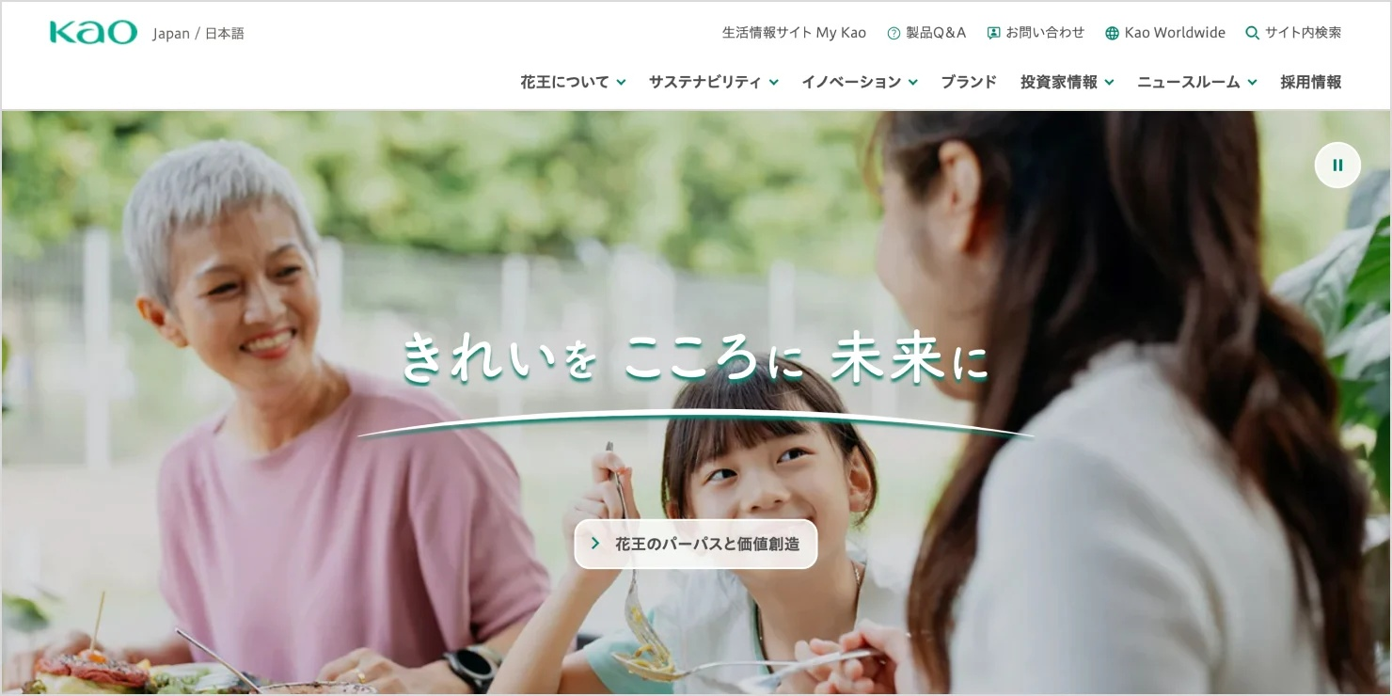
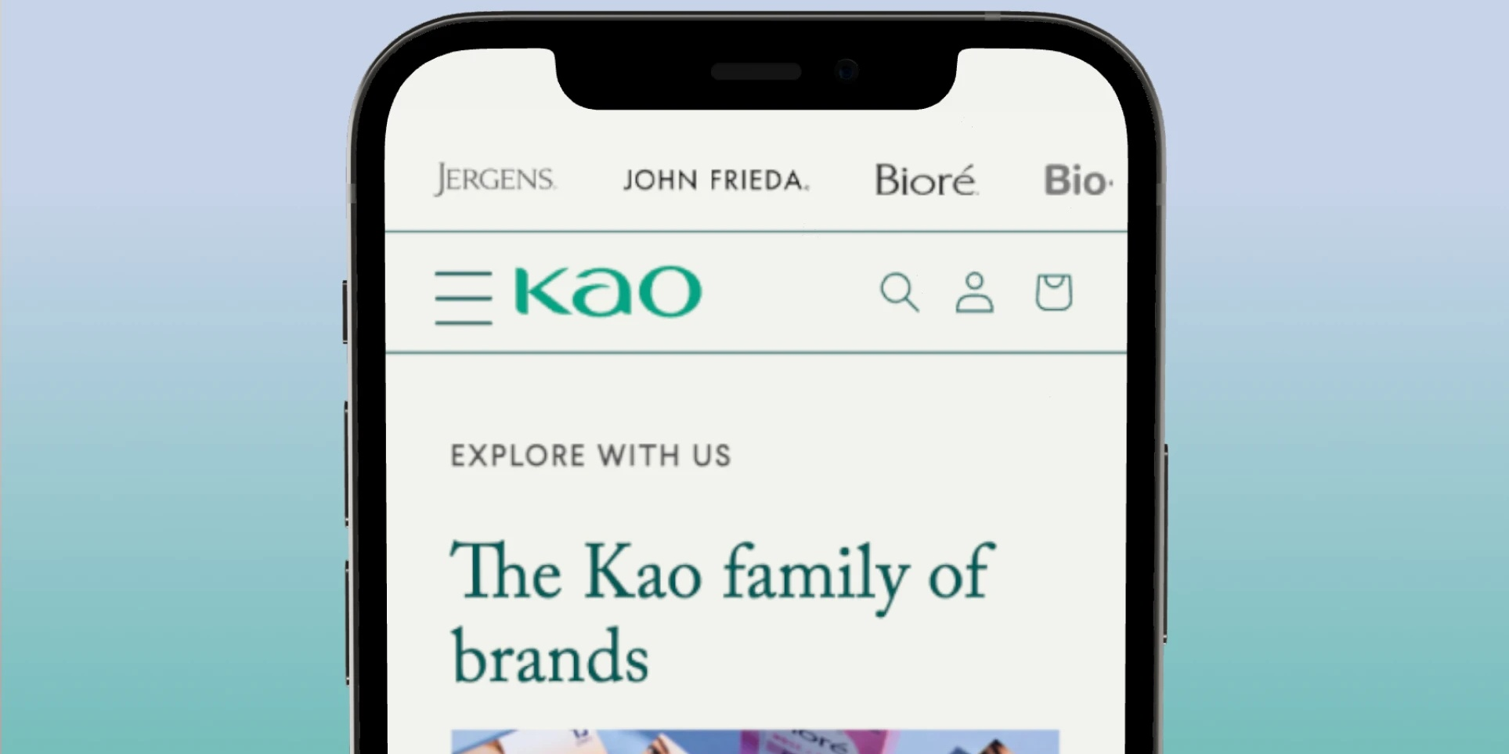
Reference UX/UI: Kao Global
Use Kao Global as inspiration for information architecture, clean design and brand navigation.
01
Corporate clarity
02
Brand portfolio hub
03
Clean human look
Clear top navigation for company, purpose, innovation, sustainability and brands.
Large portfolio browsing by category with simple brand entry points.
Soft, everyday care visuals that communicate trust and product quality.
Reference direction: Kao Global corporate site structure + brand gateway behavior. Visual identity must remain Arigeo.
ARIGEO WEBSITE BRIEF

Slide 5
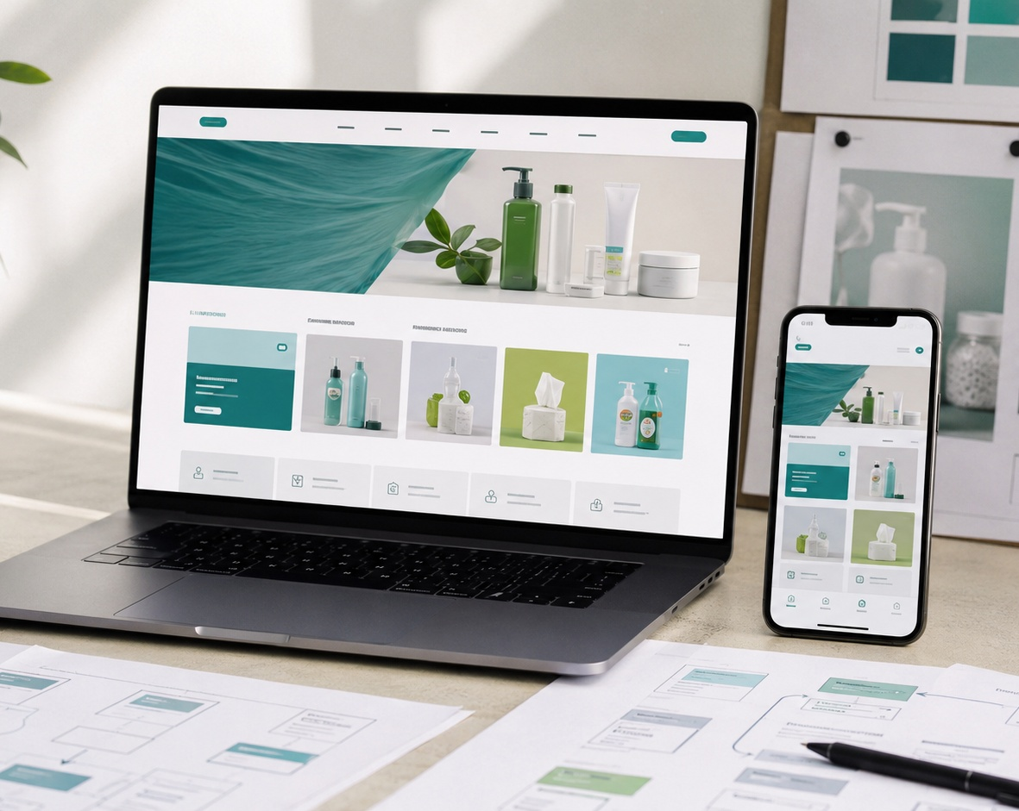
05
Arigeo visual application
Bring the logo system into the brief: white space, strong black typography and a confident red brand signal.
Brand impression
Modern corporate confidence with a high-contrast logo, supported by clean home and skincare visuals.
WHITE
RED
BLACK
Kao-inspired UX: organized, calm and easy to browse. Arigeo UI: bolder brand contrast.
ARIGEO WEBSITE BRIEF
5

Slide 6
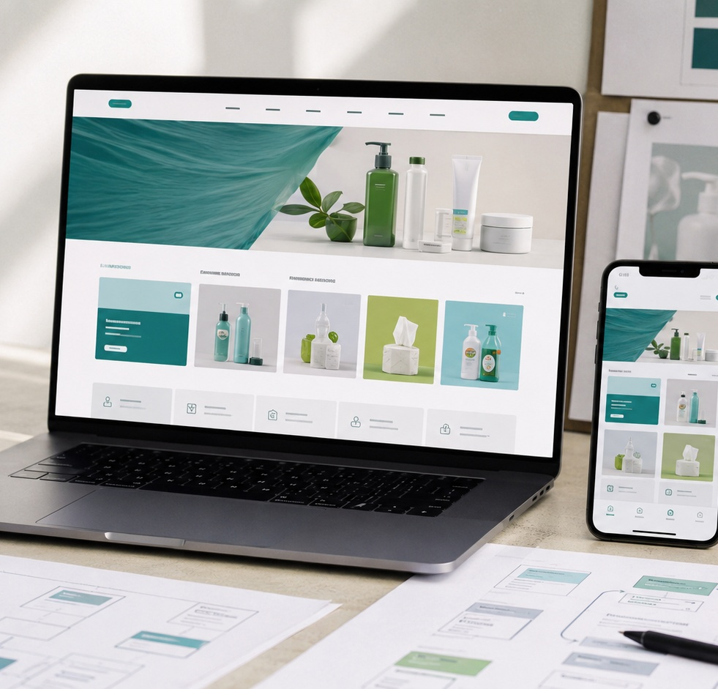
06
UX principles to apply
The website should feel premium, simple and trustworthy across both household and skincare businesses.
01
Simple navigation
Top-level menu must help users quickly understand company, brands, innovation, sustainability and contact.
02
Category-first discovery
Visitors can filter by Household, Skincare, Cleansing, Barrier Care, Anti-bac, etc.
03
Trust-building content
Use proof points, benefits, quality standards, science/nature story and corporate responsibility.
ARIGEO WEBSITE BRIEF
6

Slide 7
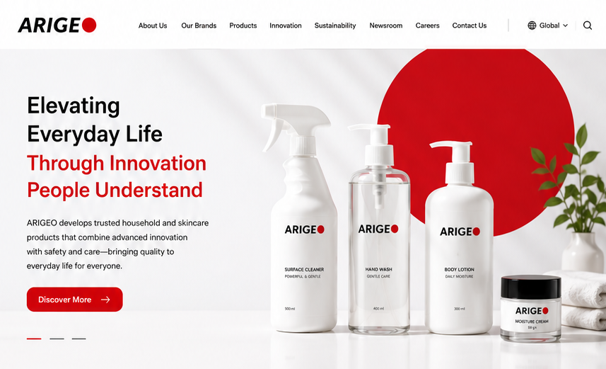
Proposed website sitemap
About Us
Short story, vision, purpose and credibility.
Company About / Purpose
ARIGEO Way (Ref. Link Here)
Our Purpose :
Our Mission:
Our Vision :
Our Values :
Responsible by P Fa
Quality with Purpose
Innovation That Understands People
Care Beyond the Product
Our Principles
We Make Safety and Quality Non-Negotiable
We Improve Every Day
We Grow Responsibly
We Succeed Together
Our Commitment

Slide 8
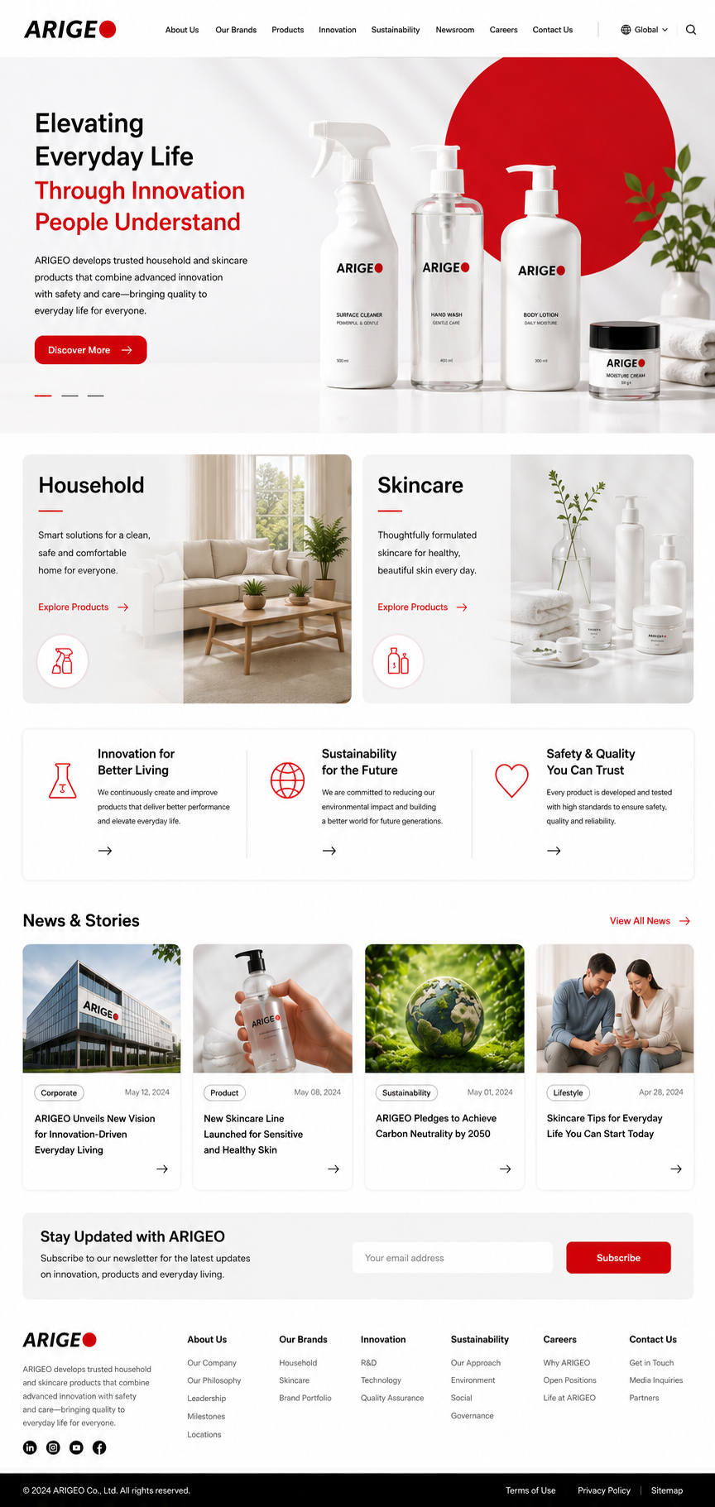
Proposed website sitemap
Our Brands
HOUSEHOLD FOUNDATION
Captainmaid covers floor cleaner, kitchen cleaner, glass cleaner, dishwash, hand wash, bathroom cleaner, washing machine cleaner and anti-bac home care.
SKINCARE FOUNDATION
GenuLeaf and CeraTory focus on soothing, brightening, barrier repair, cleansing and acne-care product lines
Responsible by Graphic team
Overall product by category

Slide 9
Proposed website sitemap
Products
Household + skincare portfolio with category filters.
Captainmaid
-Floor Cleaner
-Bathroom Cleaner
-Kitchen Cleaner
-Glass Cleaner
-Multi-purpose Disinfectant
-Dish washer
-View All
HOUSEHOLD
SKINCARE
GenuLeaf
-Gexx
-Gexxx
CeraTory
-Cexx
-Cexxx
Responsible by Graphic team
Navigation to Brand Product listing
Click to input data

Slide 10
09
Brand & product page requirements
Product pages should be light, filterable and easy to maintain without looking like a heavy e-commerce site.
Brand landing page
Each brand has its own story, benefit focus, product categories, hero products and visual identity within the Arigeo system.
Product listing
Filter by brand, category, concern, product type and launch collection. Include image, product name, size and key benefit.
Overview, usage, key ingredients/technology, safety or quality claims, related products and contact CTA.
Reference behavior
CMS usability
Kao-style brand hub: simple category browsing, unified brand entry, clean product discovery.
Marketing team must be able to add future products from the master plan without agency support every time.
ARIGEO WEBSITE BRIEF
9

Slide 11
Proposed website sitemap
Innovation
R&D / Ingredients / Standards
Sustainability/ responsibility
Care for home, skin & planet

Slide 12
Proposed website sitemap
Newsroom
Carrers

Slide 13

Proposed website sitemap
Contact Us
ARIGEO Address
123 xxx, BKK 1234
Tel. +66 2xxxxxxx
Email: XXXX@arigeo.co.th
Map : XXXXXXX

Slide 14
10
Content and functionality scope
What the agency should plan, design and hand over for the first website version.
Company profile, brand stories, product copy, claims support, news, contact text.
Recommended TH / EN structure with scalable CMS fields for both languages.
Content
Language
General enquiry, partnership/distributor enquiry, career/contact routing.
SEO
Page titles, meta descriptions, clean URL structure, product/category keywords.
Forms
GA4, GTM setup and conversion events for contact, brand clicks, product views.
CMS
Admin-friendly product, brand, news and banner modules.
Analytics
Important: design system must support future product launches
ARIGEO WEBSITE BRIEF
10

Slide 15

11
Visual system direction
A nature-science look: fresh, clean and credible, now grounded in Arigeo’s red / black / white brand language.
PALETTE APPLICATION
Black
Arigeo red
White
Soft neutral
KAO cue green
TYPOGRAPHY
Modern sans-serif, generous spacing, strong readability on mobile.
PHOTOGRAPHY
Bright home rituals, skin textures, natural ingredients, clean product still life and light lab/science moments.
INTERFACE FEELING
Large white space, accessible contrast, clear CTA hierarchy and no clutter.
ARIGEO WEBSITE BRIEF
11

Slide 16
12
Agency deliverables
The agency should deliver enough detail for internal approval and a smooth development handoff.
1
2
3
4
5
Discovery
UX
UI
Prototype
Handoff
Workshop, content audit, reference analysis, user journeys
Sitemap, wireframes, navigation, content blocks
Homepage, key templates, design system, responsive views
Clickable Figma prototype for approval and feedback
Assets, specs, CMS content model, QA checklist
All design files should be editable and structured for internal team review.
ARIGEO WEBSITE BRIEF
12

Slide 17
Mockup

